Slide 1



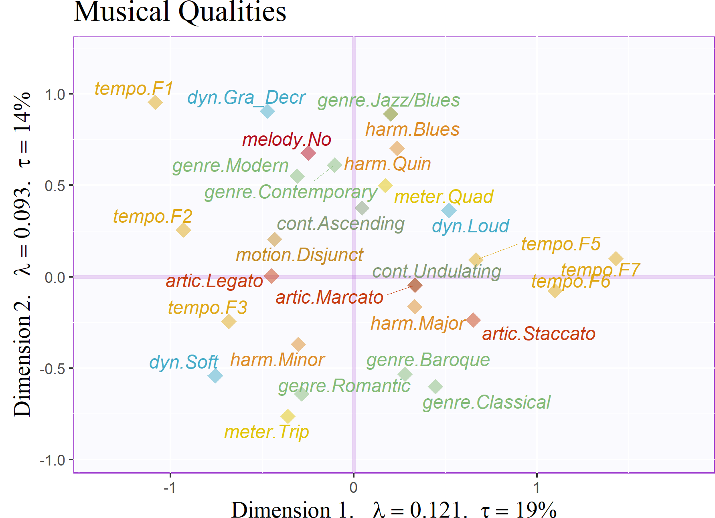
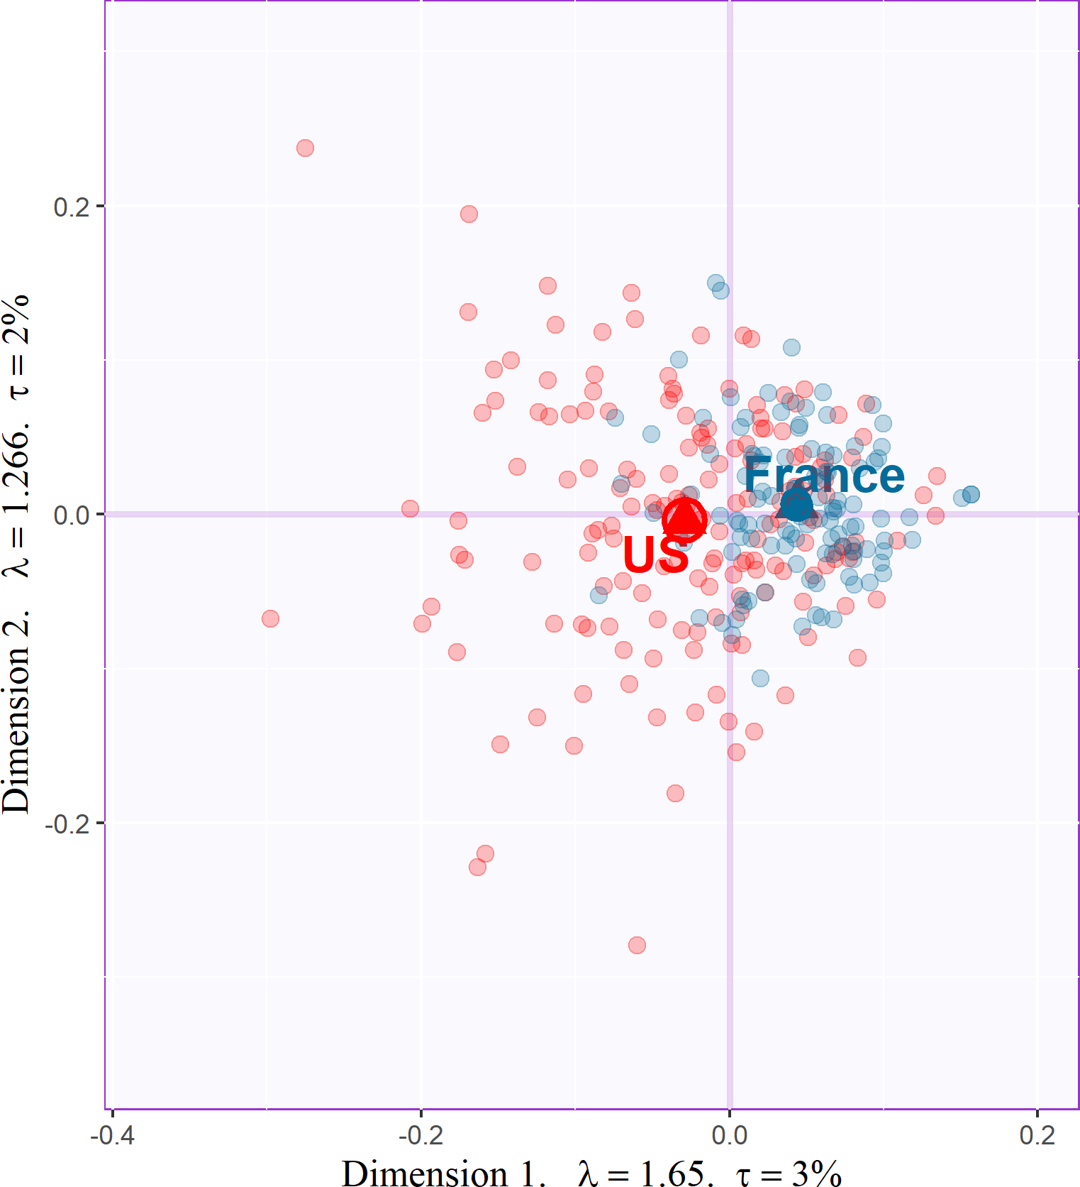
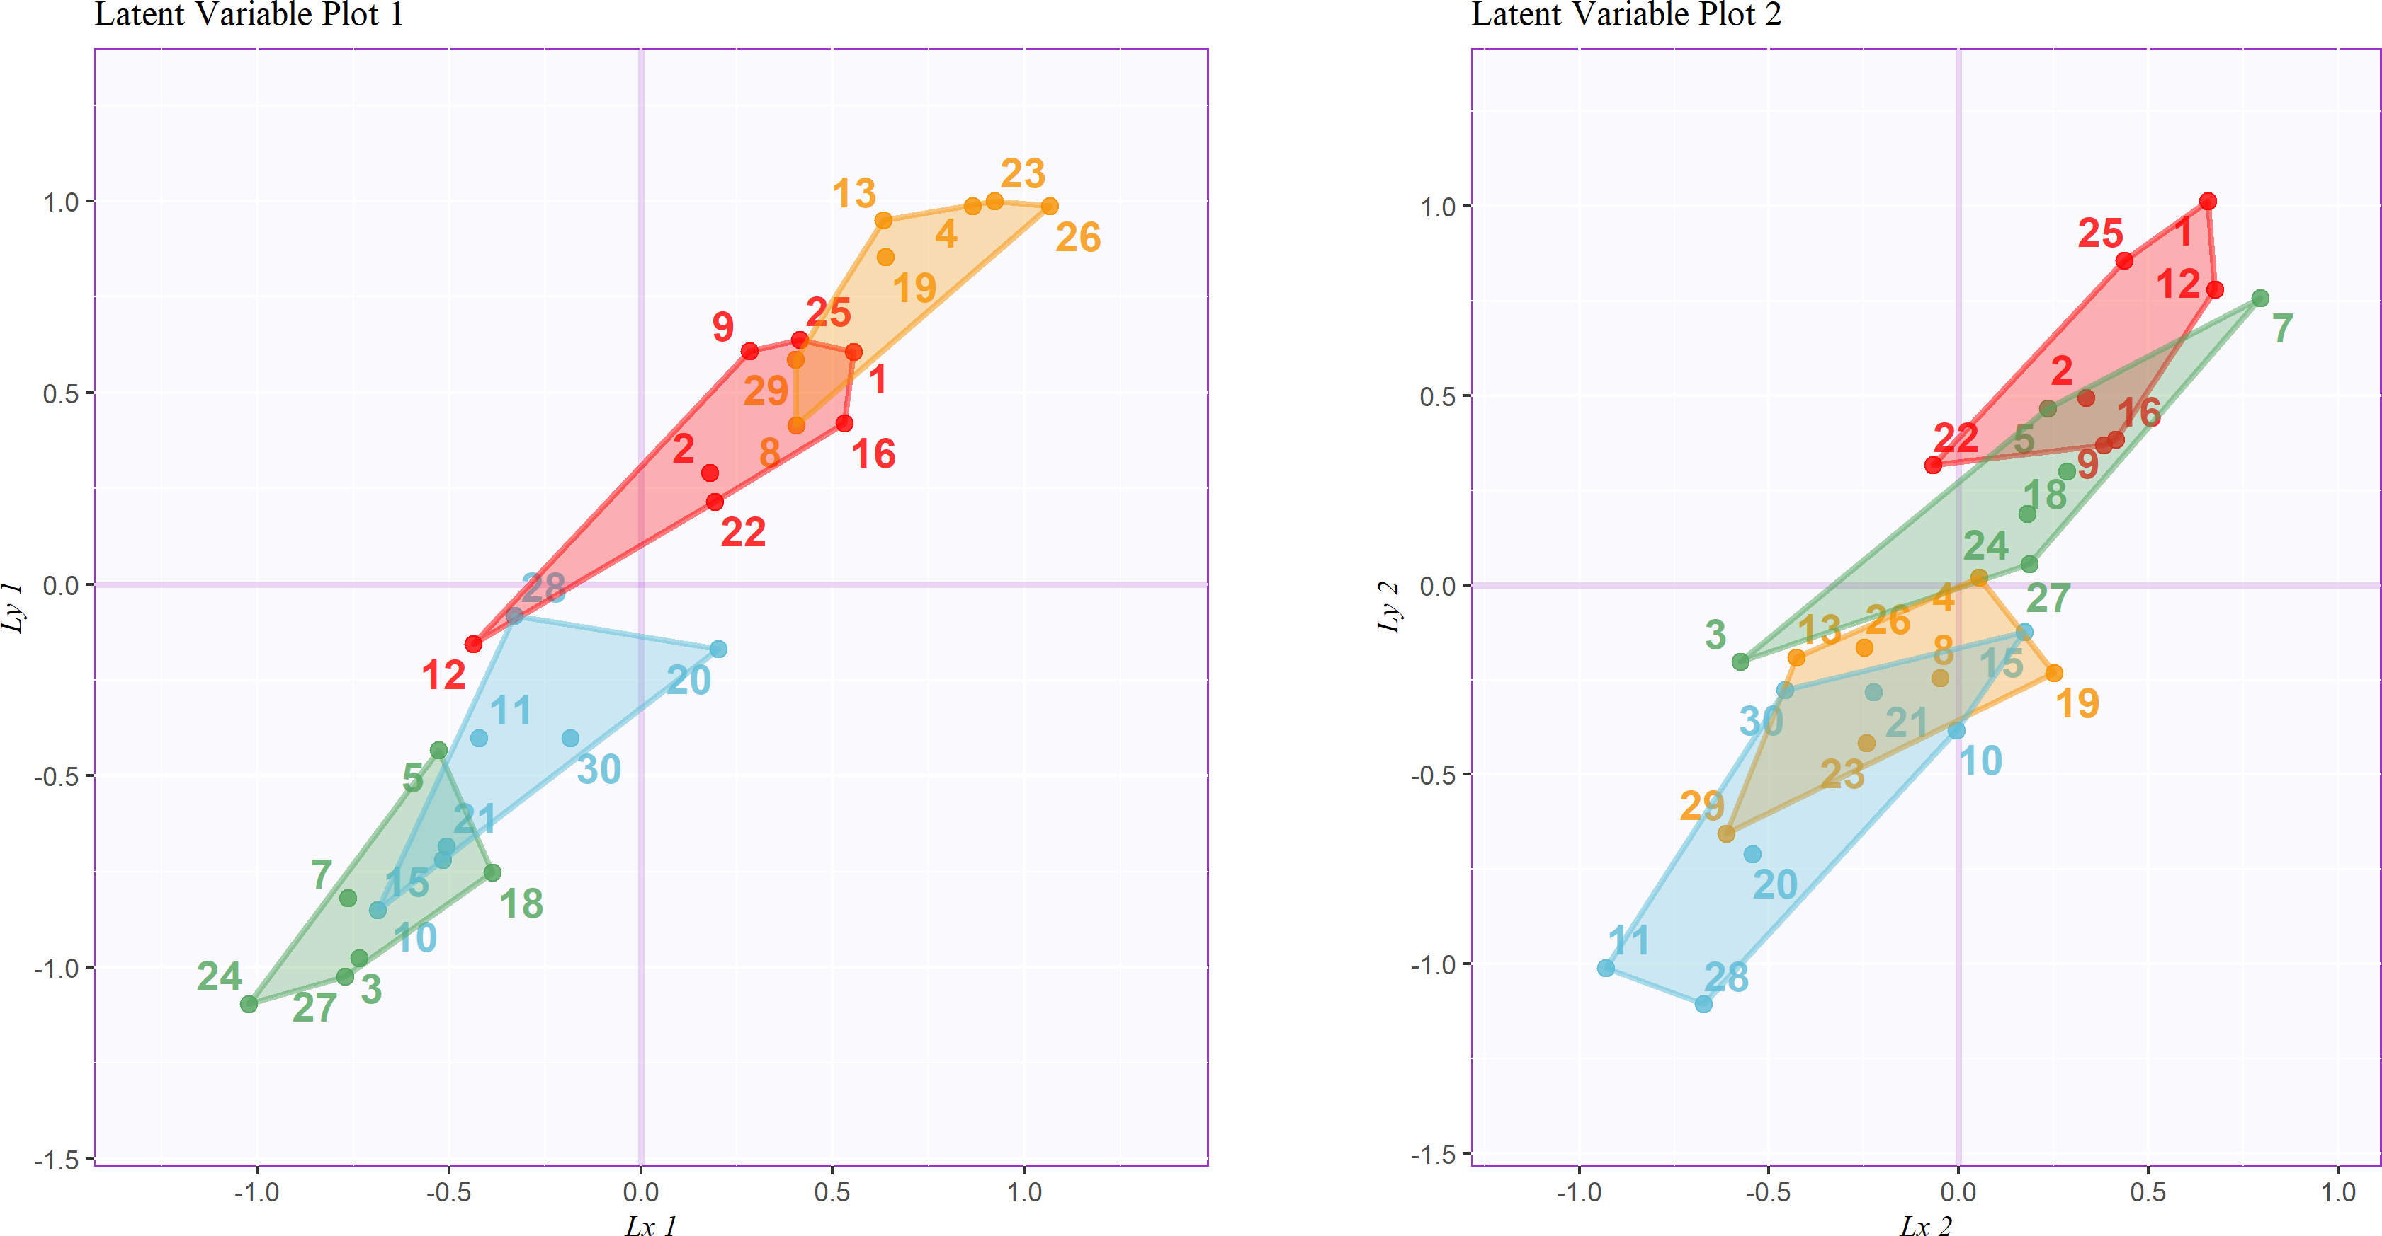
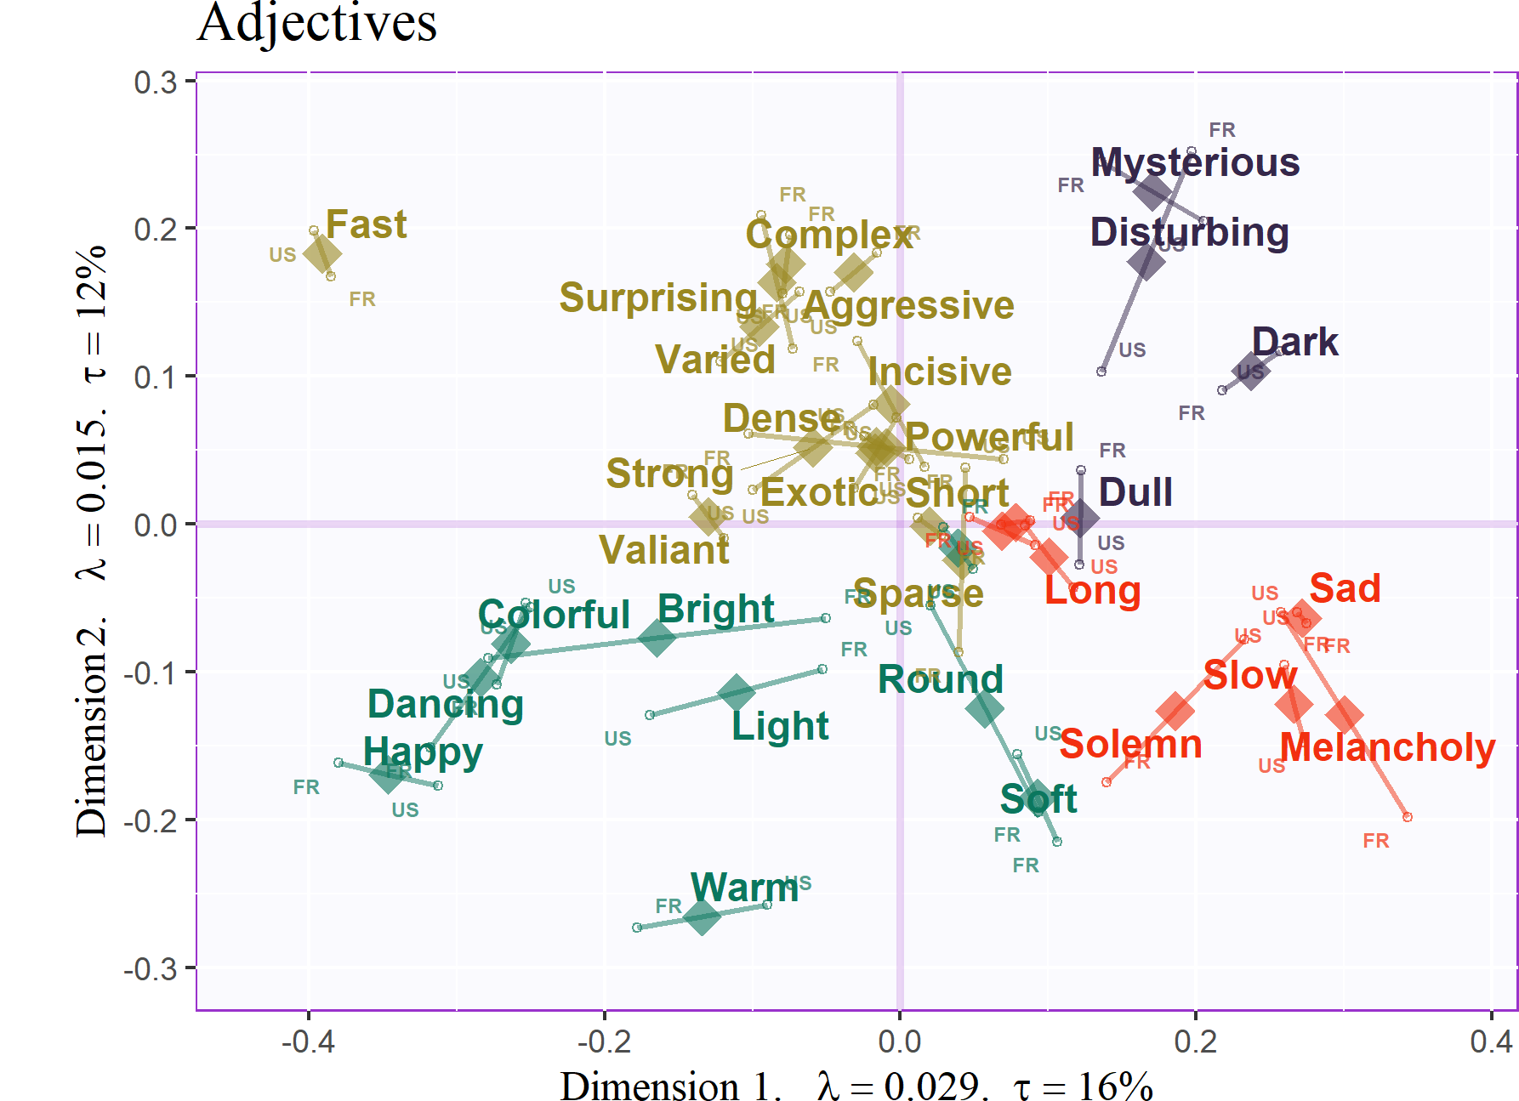
Music Descriptor Space
School of Brain and Behavioral Sciences
Music Perception and Cognition Lab
https://www.utdallas.edu/research/mpac/
For questions or correspondence,
contact: bmizener@utdallas.edu
Transfrontaliere BioEcoAgro
Applied consumer and sensory sciences
https://www.isa-lille.com/research/sensory-analysis/
Mizener, Brendon; Vandenberghe, Mathilde; Abdi, Hervé; Chollet, Sylvie
Summary
Even when using adjectives that are not explicitly emotional, factor analysis of the adjectives used to describe the excerpts reveals the valence-arousal plane in the two strongest dimensions.
Describing music using explicit musical qualities reveals a high dimensionality; the strongest dimension can be interpreted as arousal and the second dimension can be interpreted as complexity, not arousal.
Evaluating the covariance of the latent structures between the two data sets separates the excerpts by positive and negative valence and high and low arousal
People from different countries describe music differently, but those differences appear to be semantic, not perceptual.
References
Gold: + valence, Low arousal
Green: - valence, high arousal
Red: + valence, high arousal
Blue: - valence, low arousal
*
Acknowledgements

